Slide 1
Design and Analysis of Algorithms NP-Completeness
Some Slides from: Haidong Xue
Provided by: Dr. Atif Tahir, Waheed Ahmed
Presented by: Farrukh Salim Shaikh

Slide 2
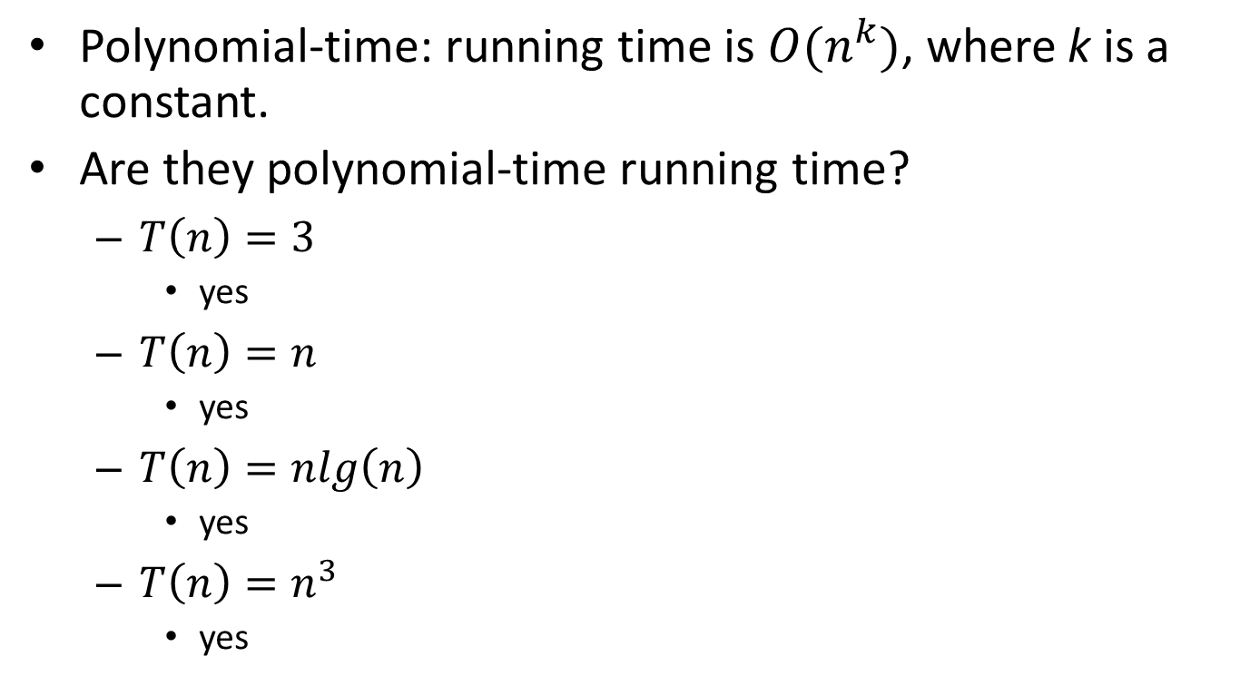
What is polynomial-time?
Polynomial-time: running time is $O(n^{k})$, where k is a constant.
Are they polynomial-time running time?
$T\left(n\right)=3$
yes
$T\left(n\right)=n$
yes
$T\left(n\right)=nlg\left(n\right)$
yes
$T\left(n\right)=n^{3}$
yes

Slide 3
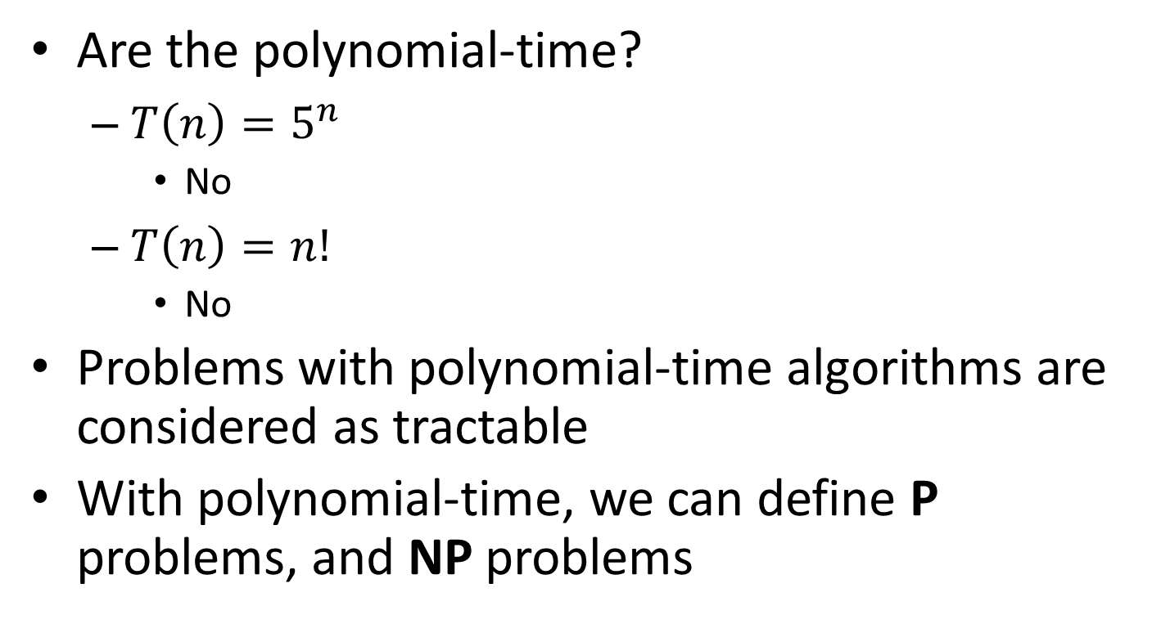
What is polynomial-time?
Are the polynomial-time?
$T\left(n\right)=5^{n}$
No
$T\left(n\right)=n!$
No
Problems with polynomial-time algorithms are considered as tractable
With polynomial-time, we can define P problems, and NP problems

Slide 4
What are P and NP?
P problems
(The original definition) Problems that can be solved by deterministic Turing machine in polynomial-time.
(A equivalent definition) Problems that are solvable in polynomial time.
NP problems
(The original definition) Problems that can be solved by non-deterministic Turing machine in polynomial-time.
(A equivalent definition) Problems that are verifiable in polynomial time.
Given a solution, there is a polynomial-time algorithm to tell if this solution is correct.

Slide 5
Why we study NPC?
One of the most important reasons is:
If you see a problem is NPC, you can stop from spending time and energy to develop a fast polynomial-time algorithm to solve it.
Just tell your boss it is a NPC problem
How to prove a problem is a NPC problem?
Will discuss later ahead.

Slide 6
What if a NPC problem needs to be solved?
Buy a more expensive machine and wait
(could be 1000 years)
Turn to approximation algorithms
Algorithms that produce near optimal solutions

Slide 7
Approximation algorithms for NP-complete problems

Slide 8
Approximation algorithms for NPC problems
If a problem is NP-complete, there is very likely no polynomial-time algorithm to find an optimal solution
The idea of approximation algorithms is to develop polynomial-time algorithms to find a near optimal solution

Slide 9
Approximation algorithms for NPC problems
E.g.: develop a greedy algorithm without proving the greedy choice property and optimal substructure.
Are those solution found near-optimal?
How near are they?

Slide 10
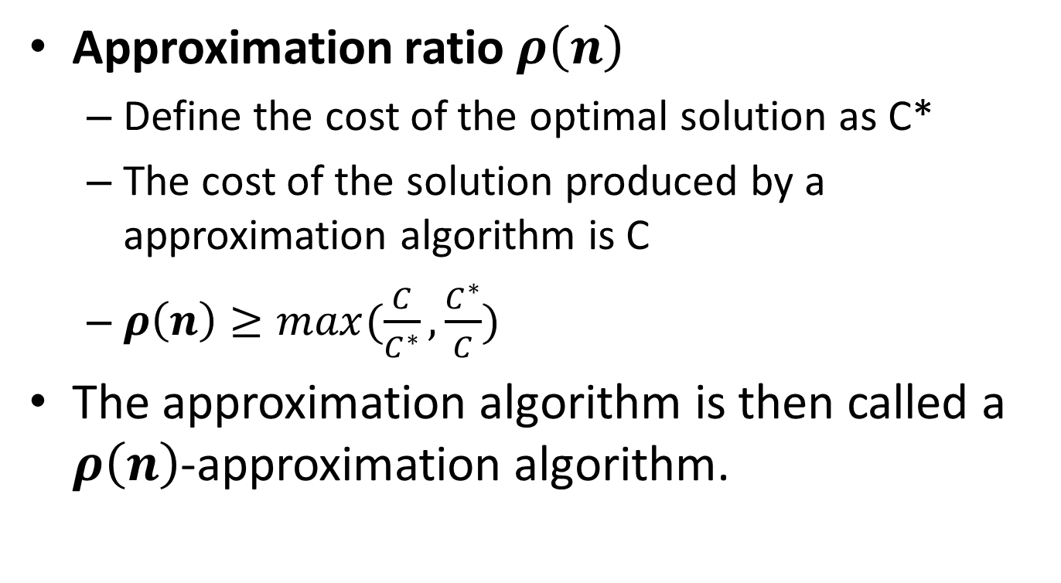
Approximation algorithms for NPC problems

Slide 11
Approximation algorithms for NPC problems
E.g.:
If the total weigh of a MST of graph G is 20
A algorithm can produce some spanning trees, and they are not MSTs, but their total weights are always smaller than 25
What is the approximation ratio?
25/20 = 1.25
This algorithm is called?
A 1.25-approximation algorithm

Slide 12
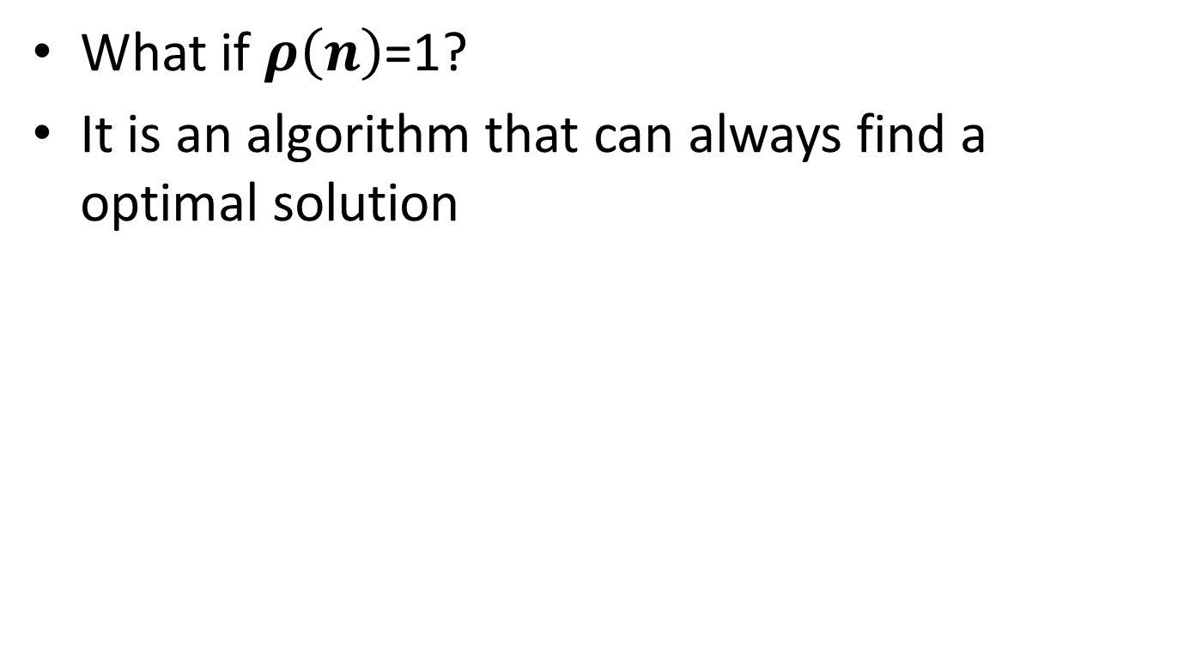
Approximation algorithms for NPC problems

Slide 13
Vertex-cover problem

Slide 14
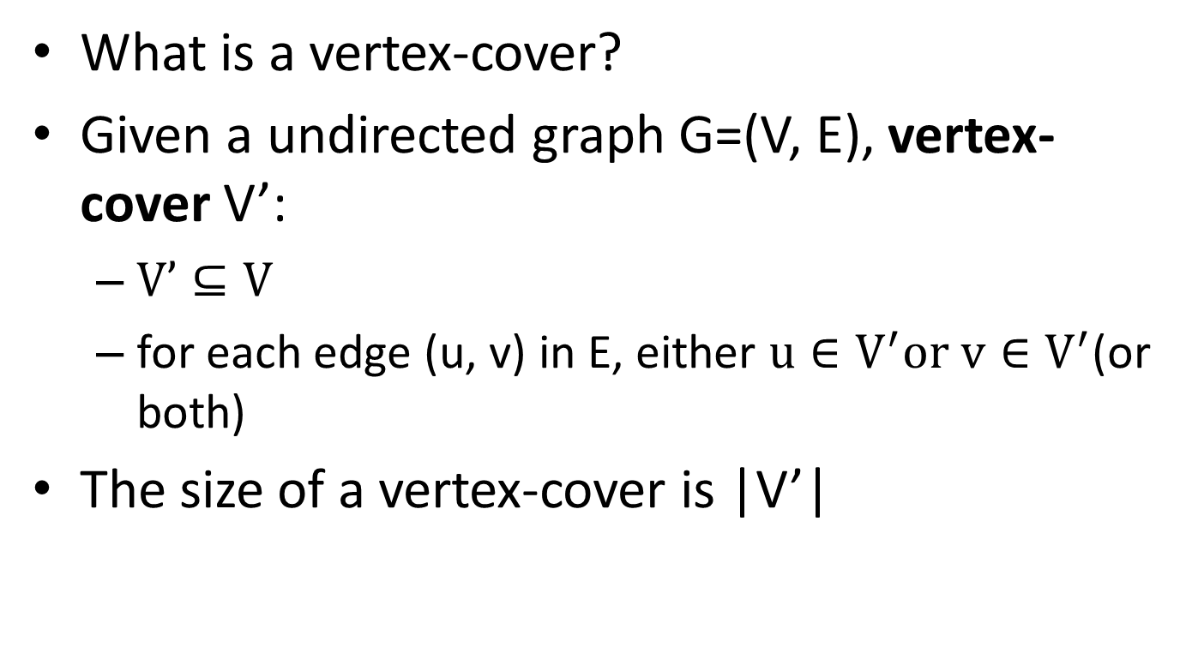
Vertex-cover problem and a 2-approximation algorithm

Slide 15
Vertex-cover problem and a 2-approximation algorithm
1
2
3
4
5
6
7
Are the red vertices a vertex-cover?
No. why?
Edges (5, 6), (3, 6) and (3, 7) are not covered by it

Slide 16
Vertex-cover problem and a 2-approximation algorithm
1
2
3
4
5
6
7
Are the red vertices a vertex-cover?
No. why?
Edge (3, 7) is not covered by it

Slide 17
Vertex-cover problem and a 2-approximation algorithm
1
2
3
4
5
6
7
Are the red vertices a vertex-cover?
Yes
What is the size?
4

Slide 18
Vertex-cover problem and a 2-approximation algorithm
1
2
3
4
5
6
7
Are the red vertices a vertex-cover?
Yes
What is the size?
7

Slide 19
Vertex-cover problem and a 2-approximation algorithm
1
2
3
4
5
6
7
Are the red vertices a vertex-cover?
Yes
What is the size?
5

Slide 20
Vertex-cover problem and a 2-approximation algorithm
1
2
3
4
5
6
7
Are the red vertices a vertex-cover?
Yes
What is the size?
3

Slide 21
Vertex-cover problem and a 2-approximation algorithm
Vertex-cover problem
Given a undirected graph, find a vertex cover with minimum size.

Slide 22
Vertex-cover problem and a 2-approximation algorithm
1
2
3
4
5
6
7
A minimum vertex-cover

Slide 23
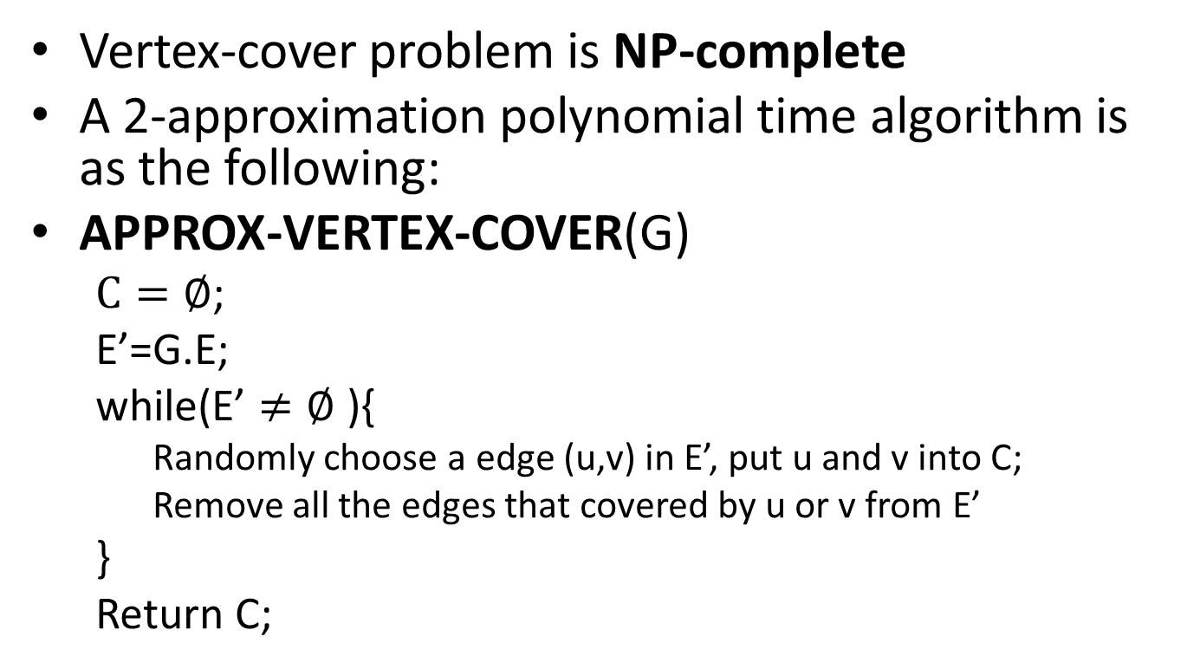
Vertex-cover problem and a 2-approximation algorithm

Slide 24
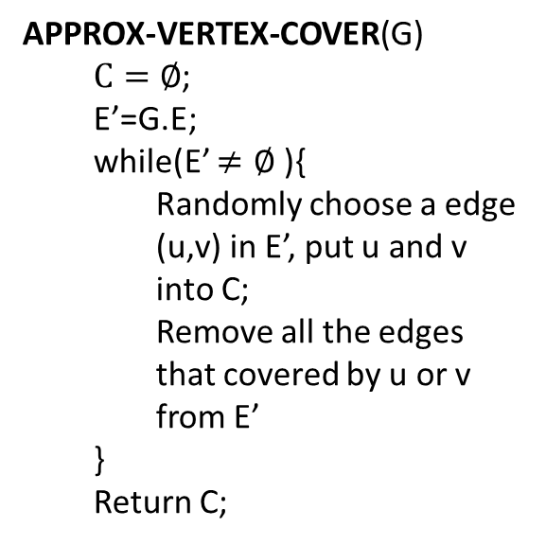
Vertex-cover problem and a 2-approximation algorithm
1
2
3
4
5
6
7

Slide 25
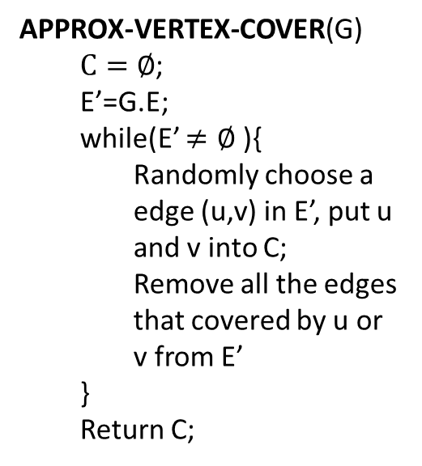
Vertex-cover problem and a 2-approximation algorithm
1
2
3
4
5
6
7
It is then a vertex cover
Size?
6
How far from optimal one?
Max(6/3, 3/6) = 2

Slide 26
Vertex-cover problem and a 2-approximation algorithm
1
2
3
4
5
6
7

Slide 27
Vertex-cover problem and a 2-approximation algorithm
1
2
3
4
5
6
7
It is then a vertex cover
Size?
4
How far from optimal one?
Max(4/3, 3/4) = 1.33

Slide 28
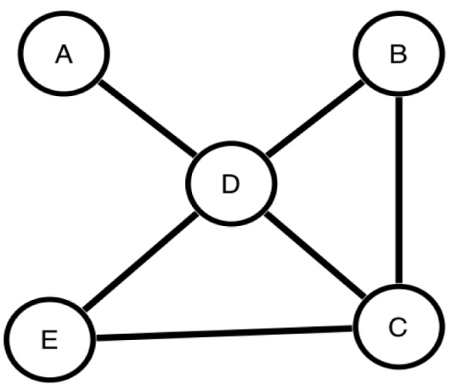
Applications of Vertex Cover Problem (VC)
Minimum Vertex Cover (MVC) problem comes into play in scheduling problems.
A scheduling problem can be modeled as a graph, where the vertices represent tasks or times, and an edge between vertices means that a conflict exists between those times or tasks.
Finding the minimum number of tasks that needs to be removed in order to resolve all conflicts is equivalent to finding a minimum vertex cover.
[Carruthers, Sarah, Ulrike Stege, and Michael Masson. "Human performance on hard non-Euclidean graph problems: Vertex cover." (2012).]

Slide 29
Vertex-cover problem and a 2-approximation algorithm
APPROX-VERTEX-COVER(G) is a 2-approximation algorithm
When the size of minimum vertex-cover is s
The vertex-cover produced by APPROX-VERTEX-COVER is at most 2s

Slide 30
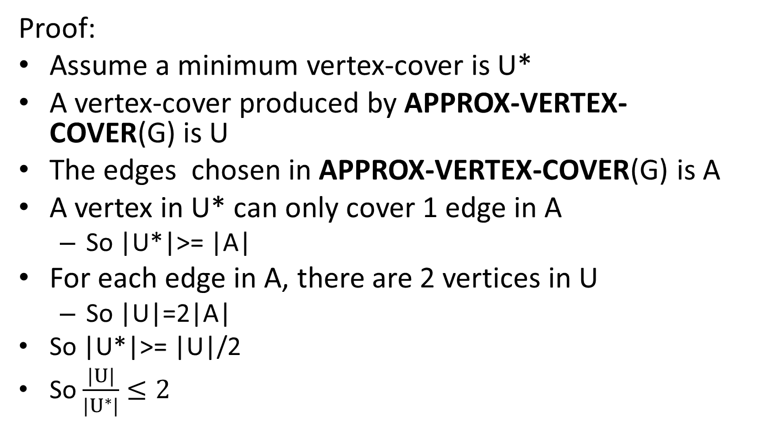
Vertex-cover problem and a 2-approximation algorithm

Slide 31
Traveling-salesman problem

Slide 32
Traveling-salesman problem
Traveling-salesman problem (TSP):
Given a weighted, undirected graph with V >= 3, start from certain vertex, find a minimum route visit each vertices once, and return to the original vertex.
1
1
2
30
2
1
20
3
4
3

Slide 33
Traveling-salesman problem
TSP is a NP-complete problem
There is no polynomial-time approximation algorithm with a constant approximation ratio
Another strategy to solve NPC problem:
Solve a special case

Slide 34
Traveling-salesman problem
Triangle inequality:
Weight(u, v) <= Weight(u, w) + Weight(w, v)
E.g.:
If all the edges are defined as the distance on a 2D map, the triangle inequality is true
For the TSPs where the triangle inequality is true:
There is a 2-approximation polynomial time algorithm

Slide 35
Metric TSP
Metric TSP is an special case of the TSP that satisfies the triangle inequality.
Each vertex should be connected with every other vertex.

Slide 36
Traveling-salesman problem
APPROX-TSP-TOUR(G)
Minimum Spanning Tree;
Creating a Cycle;
Removing Redundant Visits;

Slide 37
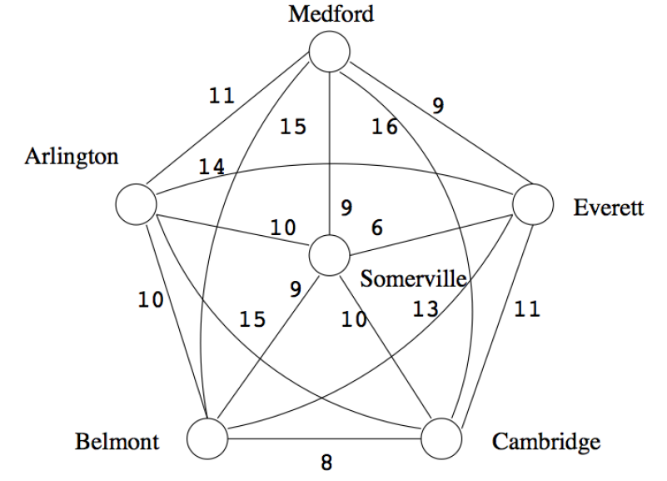
Metric TSP

Slide 38
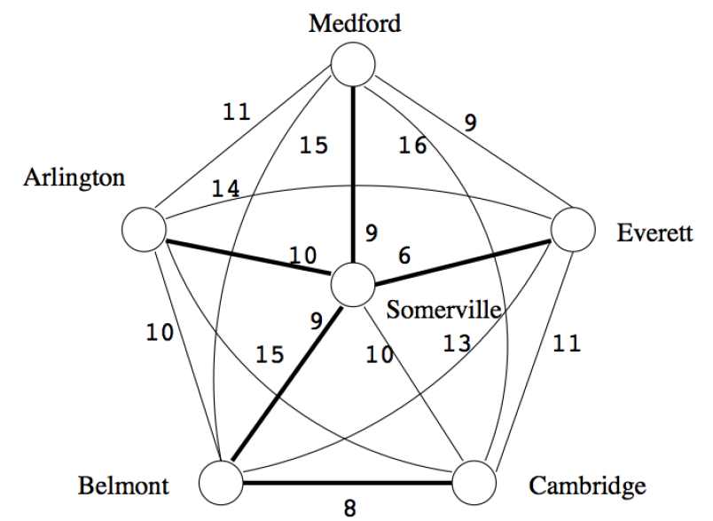
Step 1: MST

Slide 39
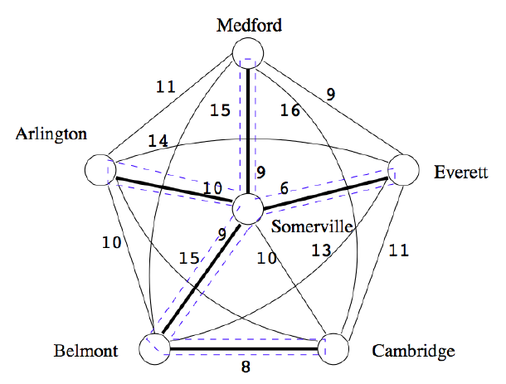
Step 2: Creating a cycle - using DFS

Slide 40
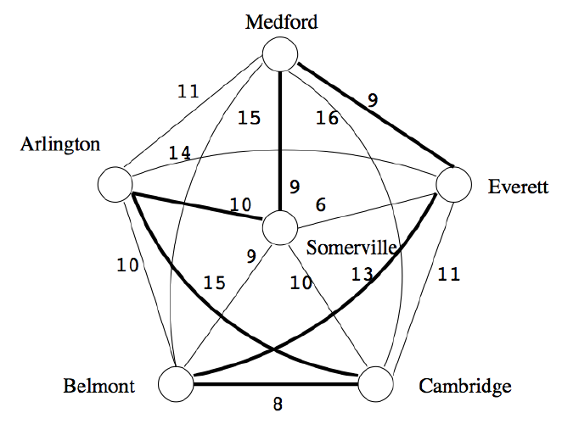
Step 3: Removing Redundant Visits of DFS
S,M,E,B,C,A with weight 64

Slide 41
2 Approximation Algorithm
Claim: The weight of the MST M is less than OPT, the weight of the TSP solution T.
i.e. OPT = w(T)
Take T and remove an edge e. T is now a spanning tree.
Because M is the MST,
w(M) ≤ w(T−e)
w(M) ≤ w(T)−w(e)
w(M) ≤ OPT−w(e)
Therefore, w(M) < OPT.
Because each edge is used exactly twice during a depth first search on a tree (once descending, once ascending)
w(W) = 2 * w(M) < 2 * OPT.
≤

Slide 42
Traveling-salesman problem
Can we apply the approximation algorithm on this one?
1
1
2
30
2
1
20
3
4
3
No. The triangle inequality is violated.

Slide 43
Traveling-salesman problem (Method 2)
APPROX-TSP-TOUR(G)
Find a MST m;
Choose a vertex as root r;
return preorderTreeWalk(m, r);

Slide 44
Traveling-salesman problem (Method 2)
Use Prim’s algorithm to get a MST
a
d
e
b
f
g
c
h
For any pair of vertices, there is a edge and the weight is the Euclidean distance
Triangle inequality is true, we can apply the approximation algorithm

Slide 45
Traveling-salesman problem (Method 2)
Use Prim’s algorithm to get a MST
a
d
Choose “a” as the root
e
b
f
g
Preorder tree walk
c
a
b
c
h
d
e
f
g
h
For any pair of vertices, there is a edge and the weight is the Euclidean distance
Triangle inequality is true, we can apply the approximation algorithm

Slide 46
Traveling-salesman problem (Method 2)
Use Prim’s algorithm to get a MST
a
d
Choose “a” as the root
e
b
f
g
Preorder tree walk
c
a
b
c
h
d
e
f
g
h
The route is then…
Because it is a 2-approximation algorithm
A TSP solution is found, and the total weight is at most twice as much as the optimal one

Slide 47
The set covering problem

Slide 48
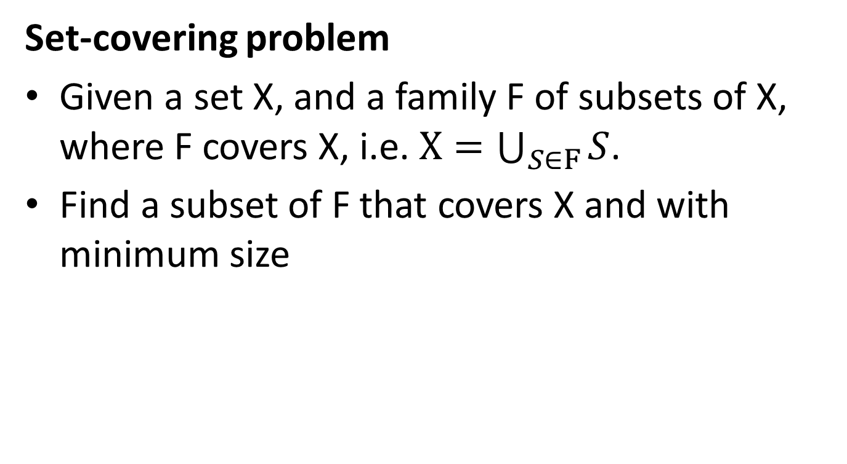
The set-covering problem

Slide 49
The set-covering problem
X:
a
b
c
h
d
e
{f1, f3, f4} is a subset of F covering X
F:
{f1, f2, f3, f4} is a subset of F covering X
f1:
a
b
f5:
a
{f2, f3, f4, f5} is a subset of F covering X
f2:
b
f3:
c
h
Here, {f1, f3, f4} is a minimum cover set
f4:
d
e

Slide 50
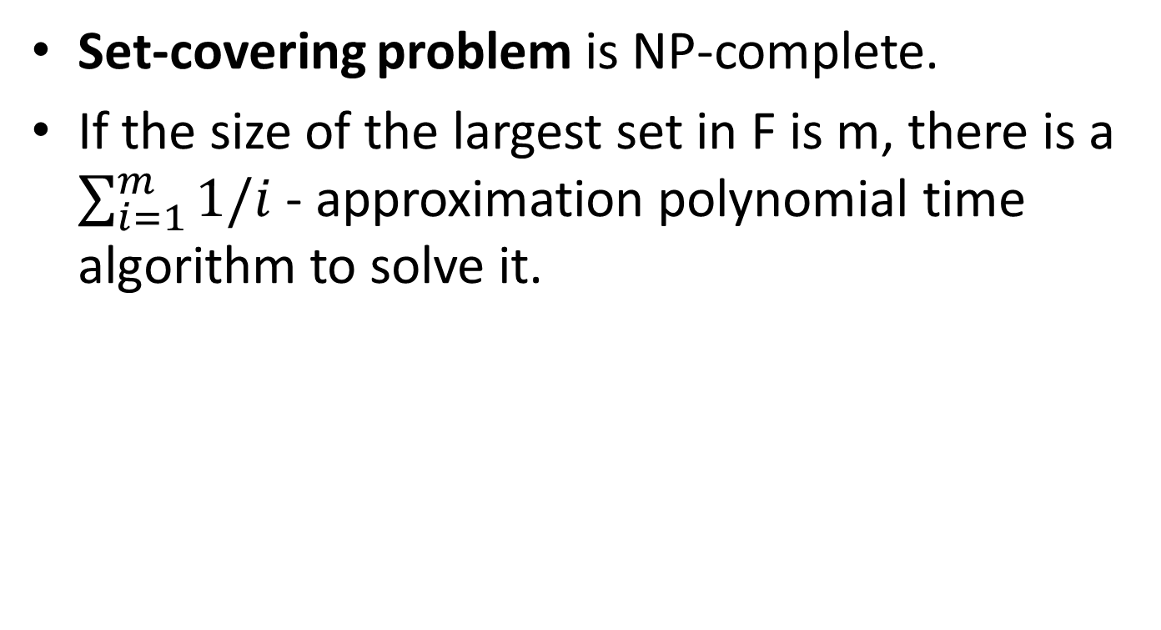
The set-covering problem

Slide 51
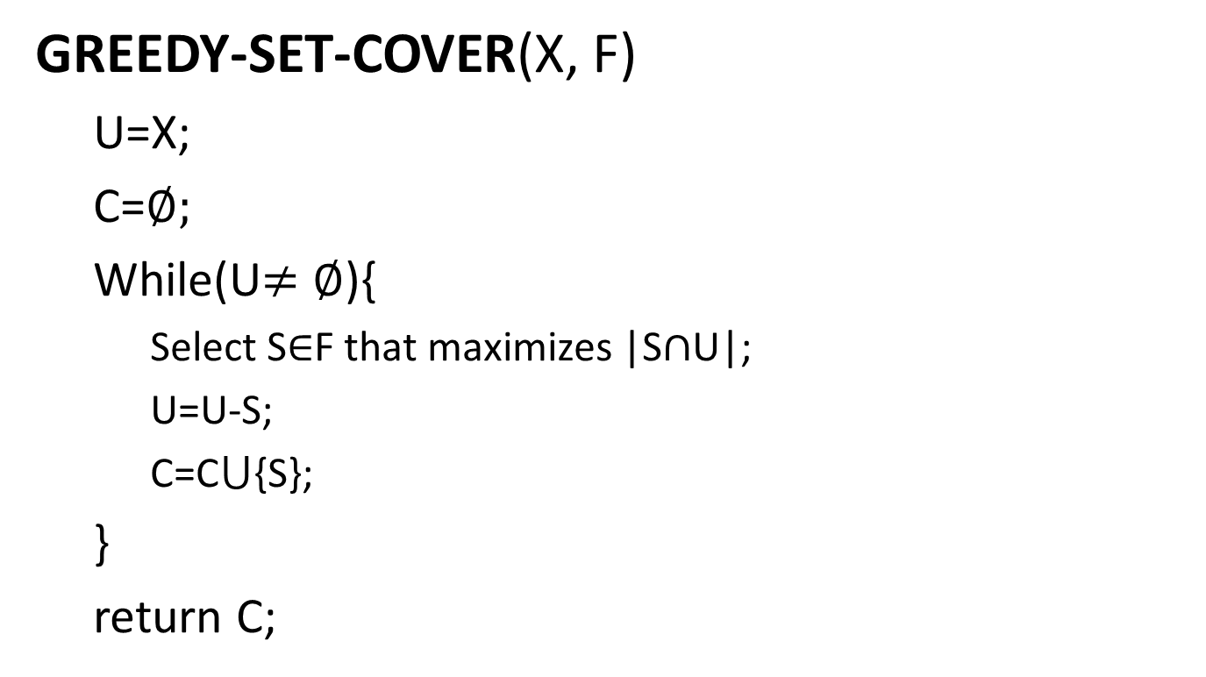
The set-covering problem

Slide 52
The set-covering problem
We can choose from f1, f3 and f4
X:
Choose f1
a
b
c
h
We can choose from f3 and f4
Choose f3
We can choose from f4
d
e
Choose f4
F:
f1:
a
b
a
b
c
h
d
e
U:
f2:
b
f3:
c
h
C:
f1:
a
b
f3:
c
h
f4:
d
e
f4:
d
e
f5:
a

Slide 53
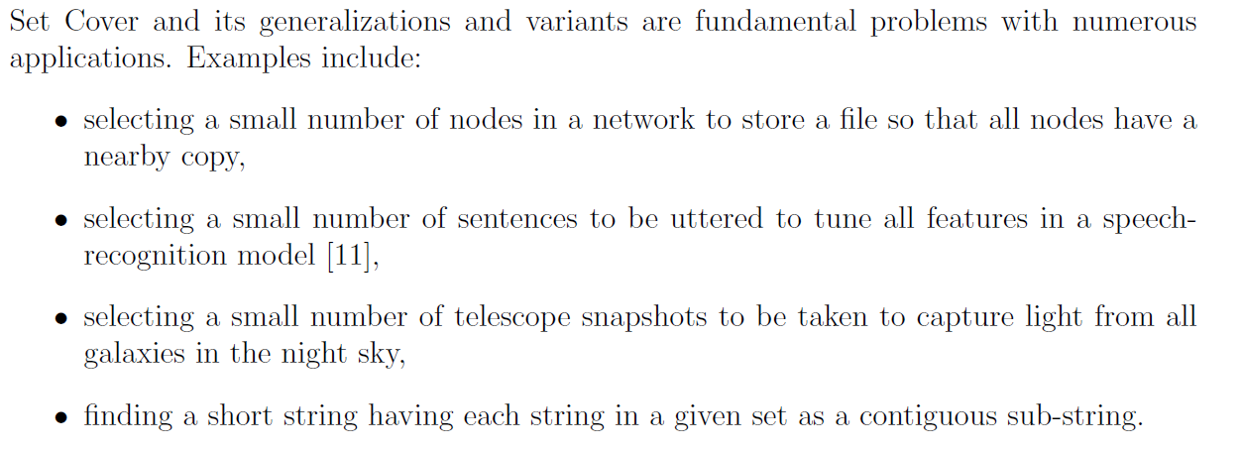

Slide 54
What exactly NP is?

Slide 55
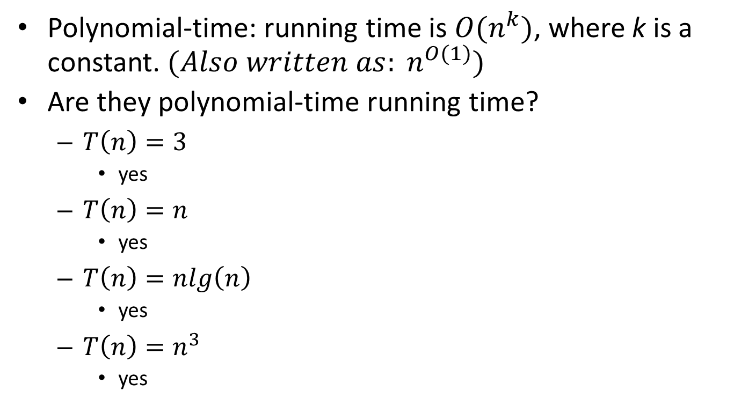
What is polynomial-time?
Revision
Polynomial-time: running time is $O(n^{k})$, where k is a constant. ${(Also written as: n}^{O(1)})$
Are they polynomial-time running time?
$T\left(n\right)=3$
yes
$T\left(n\right)=n$
yes
$T\left(n\right)=nlg\left(n\right)$
yes
$T\left(n\right)=n^{3}$
yes

Slide 56
What is polynomial-time?
Revision
Are the polynomial-time?
$T\left(n\right)=5^{n}$
No
$T\left(n\right)=n!$
No
Problems with polynomial-time algorithms are considered as tractable
With polynomial-time, we can define P problems, and NP problems

Slide 57
What are P and NP?
Revision
P problems
(The original definition) Problems that can be solved by deterministic Turing machine in polynomial-time.
(A equivalent definition) Problems that are solvable in polynomial time
Examples
A set of decision problem with yes/no answer
Calculating the greatest common divisor
sorting n numbers in ascending or descending order
search the element in the list

Slide 58
What are P and NP?
Revision
NP problems
(The original definition) Problems that can be solved by non-deterministic Turing machine in polynomial-time.
(A equivalent definition) Problems that are verifiable in polynomial time.
Given a solution, there is a polynomial-time algorithm to tell if this solution is correct
Examples
(i) Integer Factorization
(ii) Graph Isomorphism
Notes:
Examples, we have covered in NP are vertex cover, set cover, TSP etc.

Slide 59
What are P and NP?
Polynomial-time verification can be used to easily tell if a problem is a NP problem
E.g.:
Sorting, n-integers
A candidate: an array
Verification: scan it once
Max-heapify, n-nodes:
A candidate: a complete binary search tree
Verification: scan all the nodes once
Find all the sub sets of a given set A, |A|=n
A candidate: a set of set
Verification: check each set

Slide 60
NP Problems
NP = {Decision problems solvable in polynomial time via a “lucky” algorithm}. The “lucky” algorithm can make lucky guesses always “right” without trying all options.
Stage 1 Non-deterministic model (Guessing): algorithm makes guesses.
Stage 2: Deterministic (“verification”) says YES or NO () guesses guaranteed to lead to YES outcome if possible (no otherwise).
NP Problems: verification stage is polynomial

Slide 61
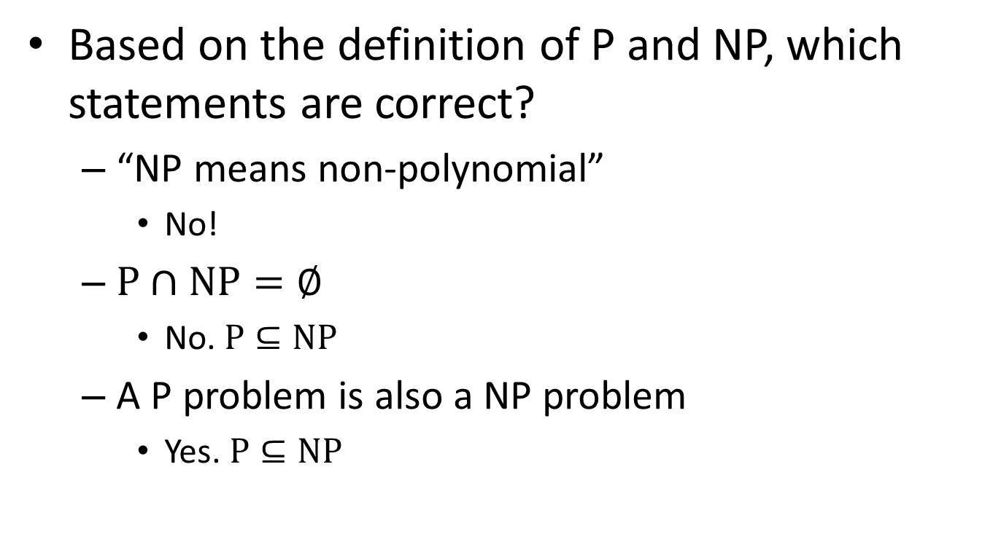
What are P and NP?
Based on the definition of P and NP, which statements are correct?
“NP means non-polynomial”
No!
$P∩NP=∅$
No. $P⊆NP$
A P problem is also a NP problem
Yes. $P⊆NP$

Slide 62
What are P and NP?
any problem solvable by a deterministic Turing machine in polynomial time is also solvable by a nondeterministic Turing machine in polynomial time. Thus, P ⊆ NP
P = NP means whether an NP problem can belong to class P problem. In other words whether every problem whose solution can be verified by a computer in polynomial time can also be solved by a
computer in polynomial time

Slide 63
What are P and NP?
In order to prove that P ≠ NP, we would need to prove that there exists a set of problems X such that:
X falls in NP. There exists an algorithm with which a nondeterministic Turing machine could solve problems in X in polynomial time
X does not fall in P. There exists no algorithm whatsoever with which a deterministic Turing machine could solve problems in X in polynomial time

Slide 64
What are NP-complete problems?
A NP-complete problem(NPC) is
a NP problem
harder than all equal to all NP problems
In other words, NPC problems are the hardest NP problems
So far, no polynomial time algorithms are found for any of NPC problems

Slide 65
What are NP-complete problems?
Most scientists believe:
However, it is not ruled out that:
NP
NP=NPC=P
NPC
P
NP-Hard problems: problems harder than or equal to NPC problems

Slide 66
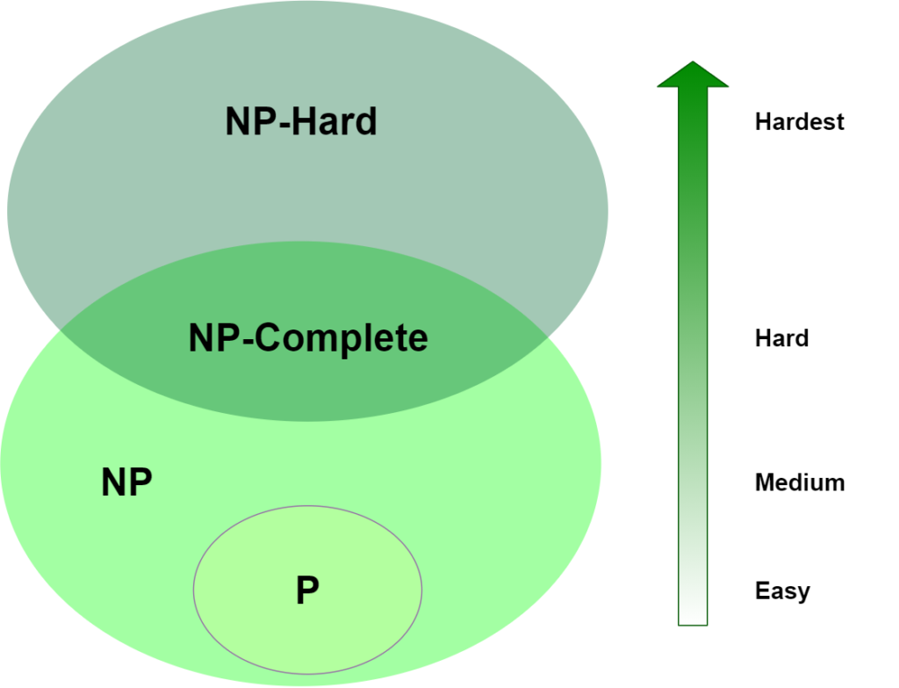
NP-Hard Region: Can be verified in P-time
NP-Hard Region: Even hard to check answer in P-time
Halting Problem,
Matrix Permanent,
Best Chess move
TSP,
Hamiltonian Cycle,
Maximum Clique,
Satisfibility
Factoring,
Graph isomorphism
Sorting,
Search Element,
Graph Connectivity
Notes:
NOW P=NP ? is the biggest question which is still unsolved. to solve this you have to prove either way given below
1.if P=NP then give solution for the algorithm in NP solved by deterministic algorithm (means possible in theory as well as in practice)in polynomial time
2.if not then prove that the algorithm in NP will take minimum exponential time to solve and it can not be solved in polynomial time by using deterministic algorithm.
The problem in NP-Hard cannot be solved in polynomial time, until P = NP. If a problem is proved to be NPC, there is no need to waste time on trying to find an efficient algorithm for it. Instead, we can focus on design approximation algorithm.

Slide 67
NP-Completeness
A problem B is NP-complete if:
(1) B ∈ NP
(2) A ≤_{p} B for all A ∈ NP
If B satisfies only property (2) we say that B is NP-hard
No polynomial time algorithm has been discovered for an NP-Complete problem
No one has ever proven that no polynomial time algorithm can exist for any NP-Complete problem
if any NP-complete problem can be solved in polynomial time, then every problem in NP has a polynomial-time solution.

Slide 68
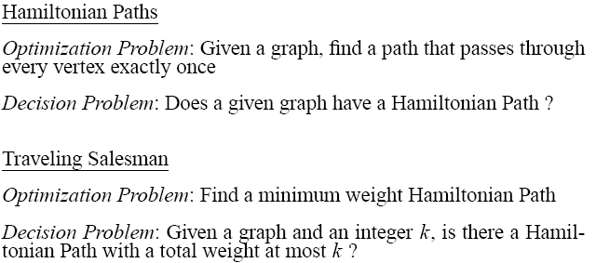
Examples
Factoring and Graph isomorphism: are NP Problems which means we can verify solution in P time. But these problems still can not reduce to any existing NP-complete problem (so these problems are not hard as NP-complete problems) . Therefore may be in the computational complexity class NP-intermediate.
Notes:
NP-hard means “at least as hard as an NP-complete problem.“
NP-complete problems—for which no efficient solution is believed to exist.
(No polynomial Algo is known but it is also not proven that in future there will be no polynomial algorithm for NP complete.
So it is open-Question )
The graph isomorphism problem is the computational problem of determining whether two finite graphs are isomorphic.
Hardest Problem are those problem which even can not be verified in Polynomial
Satisfiability problem complexity : 2^{n}
TSP = : n² 2^{n}

Slide 69
NP-Hard
An example of an NP-hard problem is Travelling Salesman Problem (TSP)
A special case of TSP, i.e. Metric TSP happens to be NP-complete.
There are decision problems that are NP-hard but not NP-complete such as the halting problem. That is the problem which asks "given a program and its input, will it run forever?“
The halting problem is not in NP since all problems in NP are decidable in a finite number of operations, but the halting problem, in general, is undecidable.
[https://en.wikipedia.org/wiki/NP-hardness]

Slide 70
Why we study NPC?
For new computational problems we encounter:
We try for a while to develop an efficient algorithm; and if this fails,
We then try to prove it NP-complete.
Find Approximate Algorithms (sub-optimal solution) if required.
How to prove a problem is a NPC problem?

Slide 71
How to prove a problem is a NPC problem?
A common method is to prove that it is not easier than a known NPC problem.
To prove problem A is a NPC problem
Choose a NPC problem B
Develop a polynomial-time algorithm translate A to B
A reduction algorithm
If A can be solved in polynomial time, then B can be solved in polynomial time. It is contradicted with B is a NPC problem.
So, A cannot be solved in polynomial time, it is also a NPC problem.

Slide 72
What if a NPC problem needs to be solved?
Revision
Buy a more expensive machine and wait
(could be 1000 years)
Turn to approximation algorithms
Algorithms that produce near optimal solutions

Slide 73
NP-Completeness Reduction

Slide 74
Reduction
Reduction is a way of saying that one problem is “easier” than another.
We say that problem A is easier than problem B, (i.e., we write “A ≤ B”)
if we can solve A using the algorithm that solves B.
Idea: transform the inputs of A to inputs of B
yes
α
f
β
Problem B
yes
no
no
Problem A
Notes:
We say that problem A is “as easy as” problem B.

Slide 75
Polynomial Reduction
Given two problems A, B, we say that A is polynomially reducible to B (A ≤_{p} B) if:
There exists a function f that converts the input of A to inputs of B in polynomial time
Polynomial time algorithm to decide A
yes
α
f
β
Polynomial time
algorithm to decide B
yes
no
no
Use a polynomial time reduction algorithm to transform A into B
Run a known polynomial time algorithm for B
Use the answer for B as the answer for A

Slide 76
Reduction
Not part of course
Reduction can be used to show:
Problem is tractable (solvable)
Problem is intractable (unsolvable)
To spread hardness.

Slide 77
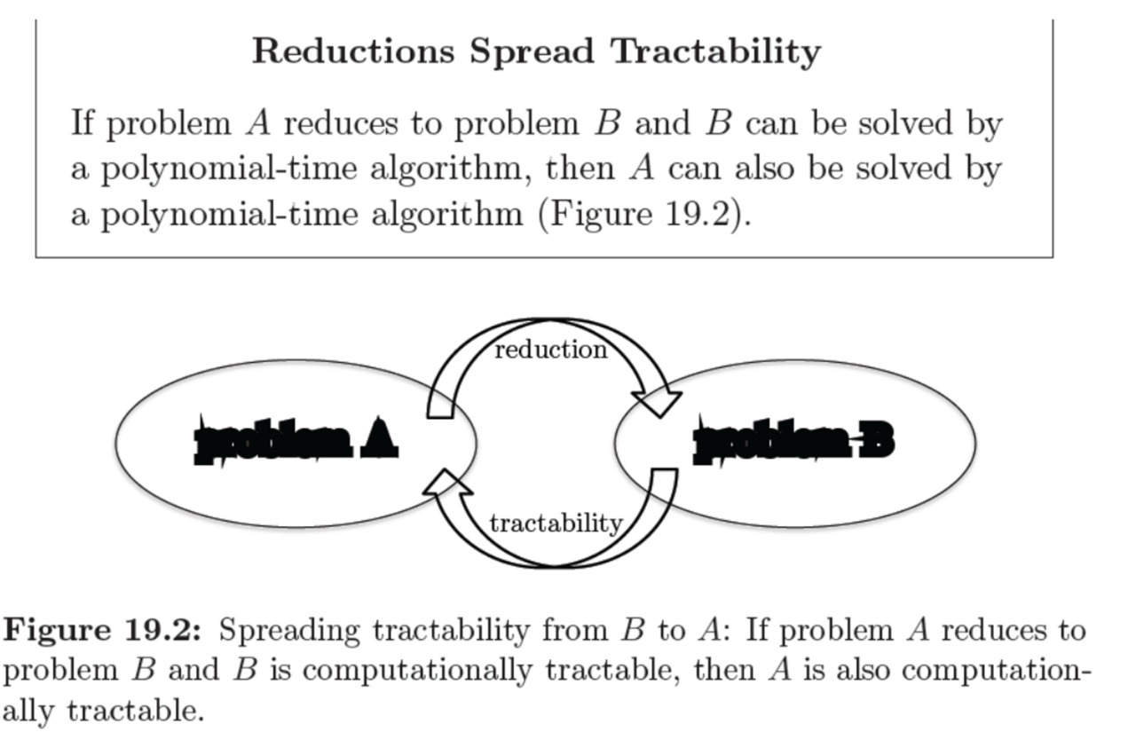
Not part of course
Median
Sorting
Problem A
Problem B
If A ≤_{p} B and B ∈ P, then A ∈ P

Slide 78
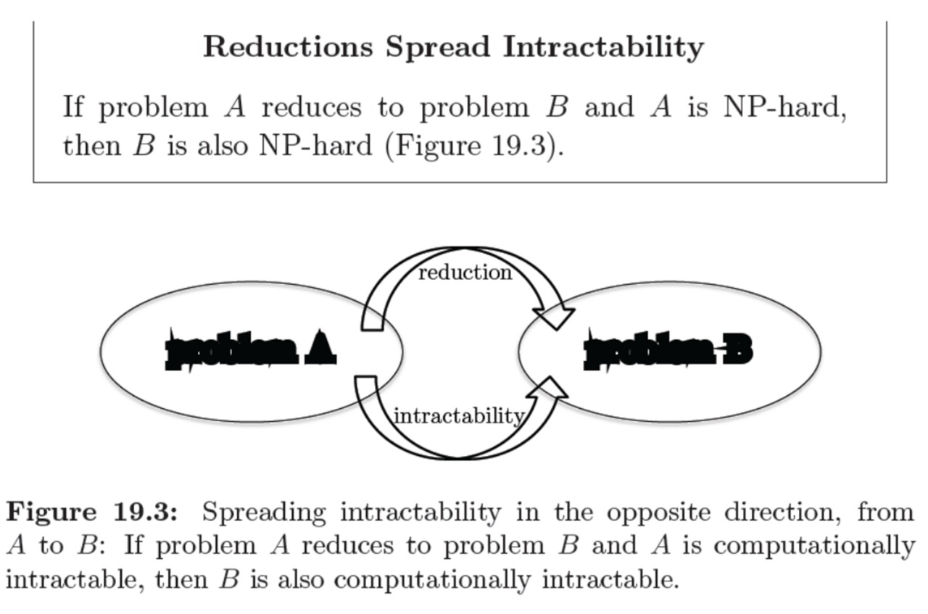
Not part of course
Independent Set
Vertex Cover
Problem A
Problem B
if A ≤_{p} B and A ∉ P, then B ∉ P

Slide 79
Implications of Reduction
Problem A reduces to problem B if you can use an algorithm that solves B to help solve A.
Cost of solving A = total cost of solving B + cost of reduction.
yes
α
f
β
Problem B
yes
no
no
- If A ≤_{p} B and B ∈ P, then A ∈ P
- if A ≤_{p} B and A ∉ P, then B ∉ P
Algorithm for Problem A

Slide 80
Reductions (Tractable Examples)
Problem A reduces to problem B if you can use an algorithm that solves B to help solve A.
Example 1. [finding the median reduces to sorting]
To find the median of N items:
Sort N items
Return item in the middle:
Cost of solving finding median = O(n log n) + 1
yes
α
f
β
Problem B
yes
no
no
Algorithm for Problem A
Cost of Sorting
Cost of Reduction

Slide 81
Reductions (Tractable Examples)
Problem A reduces to problem B if you can use an algorithm that solves B to help solve A.
Example 2. [element distinctness reduces to sorting]
To solve element distinctness on N items:
Sort N items
Check adjacent pairs for equality.
Cost of solving element distinctness = O(n log n) + O(n)
yes
α
f
β
Problem B
yes
no
no
Algorithm for Problem A
Cost of Sorting
Cost of Reduction

Slide 82
Reductions (Tractable Examples)
Convex hull. Given N points in the plane, identify the extreme points of the convex hull (in counterclockwise order).
Example 3. [Convex hull reduces to sorting.]
To solve convex hull:
Choose point p with smallest (or largest) y-coordinate.
Sort points by polar angle with p.
Consider points in order, and discard those that would create a clockwise turn.
Cost of solving element distinctness = O(n log n) + O(n)
yes
α
f
β
Problem B
yes
no
no
Algorithm for Problem A
Cost of Sorting
Cost of Reduction

Slide 83
RECIPE FOR PROVING PROBLEM Is NP-Complete
To Prove B Is NP-Complete
Prove that B is a member of the class NP. B ∈ NP
Choose an NP-complete problem A.
Prove that there is a Levin reduction from A to B.

Slide 84
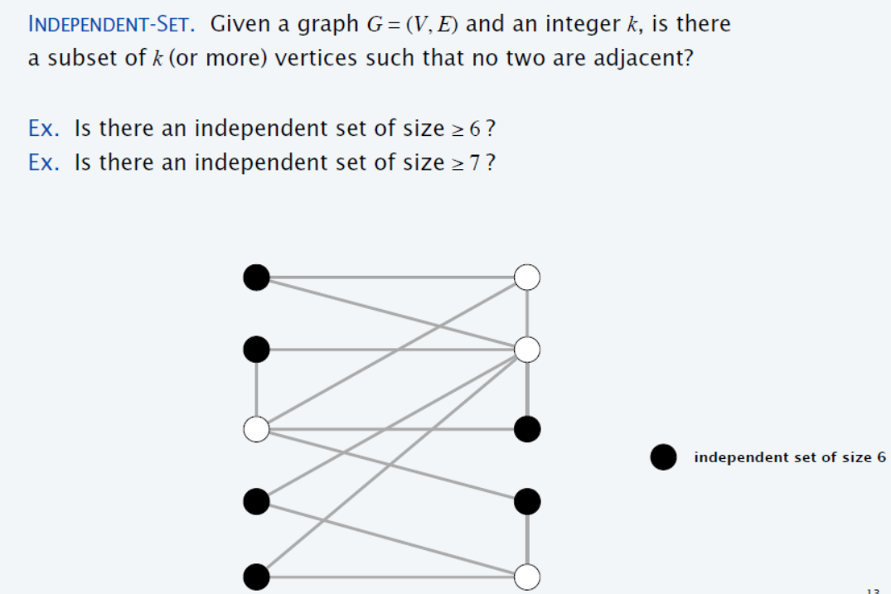
Independent Set (Example 1)
{1} is independent Set
{2, 3} is independent Set
{1, 3} is independent Set
{1, 3, 6} is independent Set
1
2
{2, 5, 6, 7} is independent Set
3
4
{1, 3, 6, 7} is independent Set
{1, 3, 6, 7, 8 , 9} is independent Set
5
6
7
8
9
10
Notes:
Independent-set set to Vertex Cover = V-Answer of Independent-set(S)

Slide 85
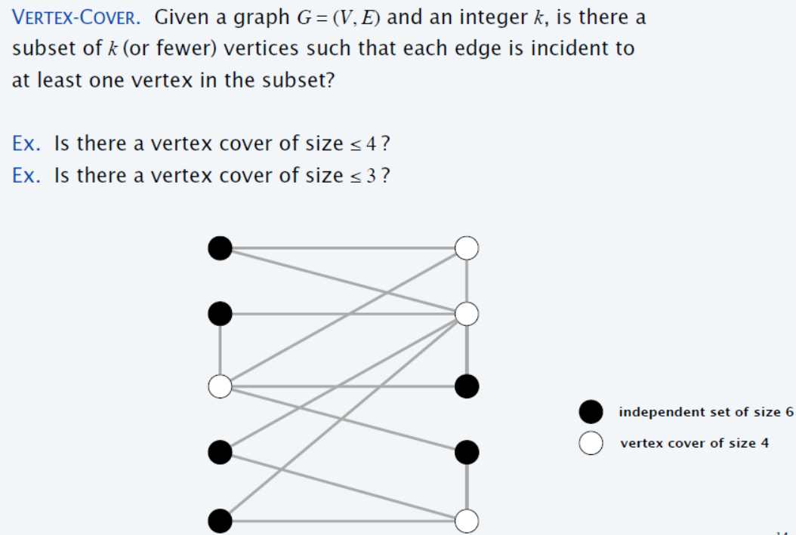
Vertex Cover (Example 1)
1
2
3
4
5
6
7
8
9
10

Slide 86
Vertex Cover is NP-Complete
Recipe to Prove a Problem Is NP-Complete
Prove that a Vertex Cover is NP-Complete
Step 1. Vertex Cover ∈ NP
Step 2. Choose an NP-Complete problem A (Independent Set).
Prove that A (Independent set) reduces to B (Vertex Cover)
INDEPENDENT-SET ≤_{p} VERTEX-COVER.
Notes:
We already have solution of Independent Set (Problem A), and we want to use the same solution of Problem A for Problem B (Vertex Cover), and this mapping of solution A to solution B (solution B needs to find out), must be in polynomial time)

Slide 87
Step 1: Vertex Cover ∈ NP
Given Graph G = (V, E) contains Vertex cover of Size 3?
S is vertex cover if every edge in E has at least one endpoint in S.
(Example V.C = {2,3,7})
1
2
3
4
5
6
7
Notes:
We can verify in P-time

Slide 88
Vertex cover and independent set reduce to one another
Lemma: INDEPENDENT-SET ≤_{p} VERTEX-COVER.
Proof: We show S is an independent set of size k,
iff V − S is a vertex cover of size n – k.
Let S be any independent set of size k.
Consider an arbitrary edge (u, v) ∈ E.
S independent ⇒ either u ∉ S, or v ∉ S, or both ∉ S.
Vertex Cover (V-S)⇒ either u ∈ V − S, or v ∈ V − S, or both ∈ V − S.
Thus, V − S covers (u, v). ▪
2
S = {4,5}
4
5
7

Slide 89
Independent Set (Example 2)
S is independent if there are no edges between vertices in S.
(Example I.S = {1,4,5,6})
V.C = V – S
(V.C ={2,3,7})
1
2
1
2
VC = V - S
3
4
5
3
4
5
6
7
6
7
Notes:
Indepenset set to Vertex Cover = V-Answer of indepense set(V)
Compliment graph of indepenset set in cliqie

Slide 90
Clique (Example 2)
Clique
Graph G = (V, E), a subset S of the vertices is a clique if there is an edge between every pair of vertices in S. (Example Clique = {1,4,5,6})
2
1
Clique of size 4
3
4
5
6
7

Slide 91
Clique is NP-Complete
Recipe to Prove a Problem Is NP-Complete
Prove that a Clique is NP-Complete
Step 1. Clique ∈ NP.
Step 2. Choose known NP-Complete problem A (IS).
Prove that A (IS) reduces to B (Clique)
IS ≤_{p} Clique.

Slide 92
Step 1: Clique ∈ NP.
Graph G = (V, E), a subset S of the vertices is a clique if there is an edge between every pair of vertices in S. (Example Clique = {1,4,5,6})
Given graph contains Clique of size = 4 ?
2
1
3
4
5
6
7
Notes:
Every vertex of S contained each other. (Mesh Connected)

Slide 93
Step 2: IS ≤_{p} Clique
Lemma: S is Independent in G iff S is a Clique in the complement of G
To reduce IS to Clique, we compute the complement of the graph. The complement has a clique of size K iff the original graph has an independent set of size K.
Construction of Complement of the graph can easily be done in polynomial time.

Slide 94
IS ≤_{p} Clique (Example 2)
2
1
2
Complement
1
3
4
5
3
4
5
6
7
6
7
Independent-Set of Size 4
Clique of Size 4

Slide 95
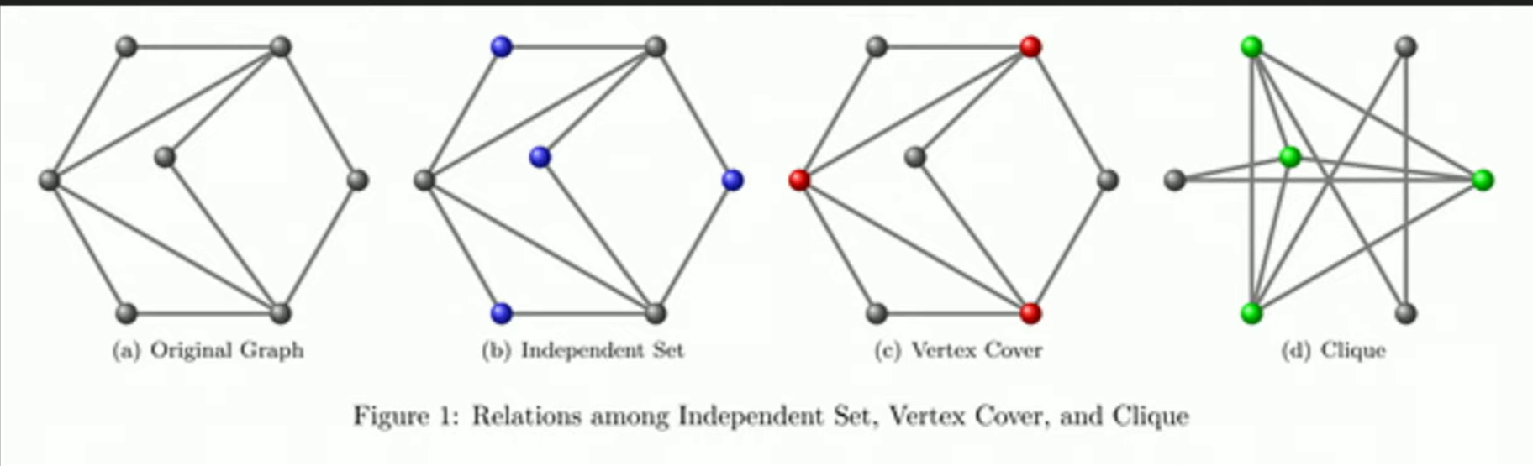
Reduction: Independent Set, Vertex Cover, and Clique (Example 3)

Slide 96
INDEPENDENT-SET is NP-Complete
Recipe to Prove a Problem Is NP-Complete
To prove that a problem B (INDEPENDENT-SET) is NP-Complete:
Step 1. INDEPENDENT-SET ∈ NP
Step 2. Choose an NP-Complete problem A (3-SAT).
Prove that A (3-SAT) reduces to B (INDEPENDENT-SET)
3-SAT ≤_{p} INDEPENDENT-SET

Slide 97
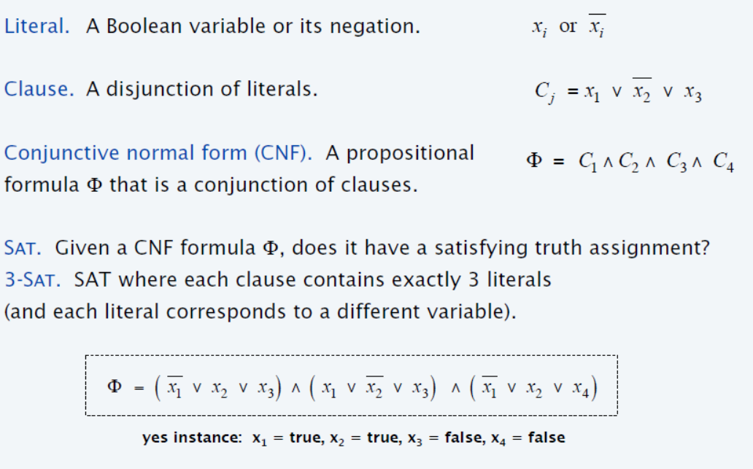
Satisfiability

Slide 98
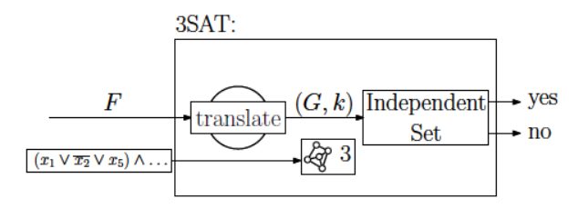
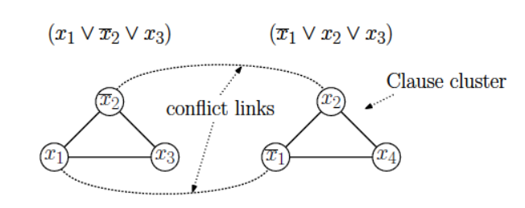
3-satisfiability reduces to independent set

Slide 99
3-satisfiability reduces to independent set

Slide 100
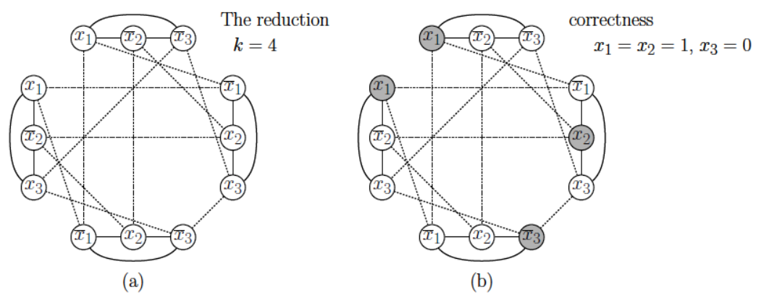
3-satisfiability reduces to independent set

Slide 101
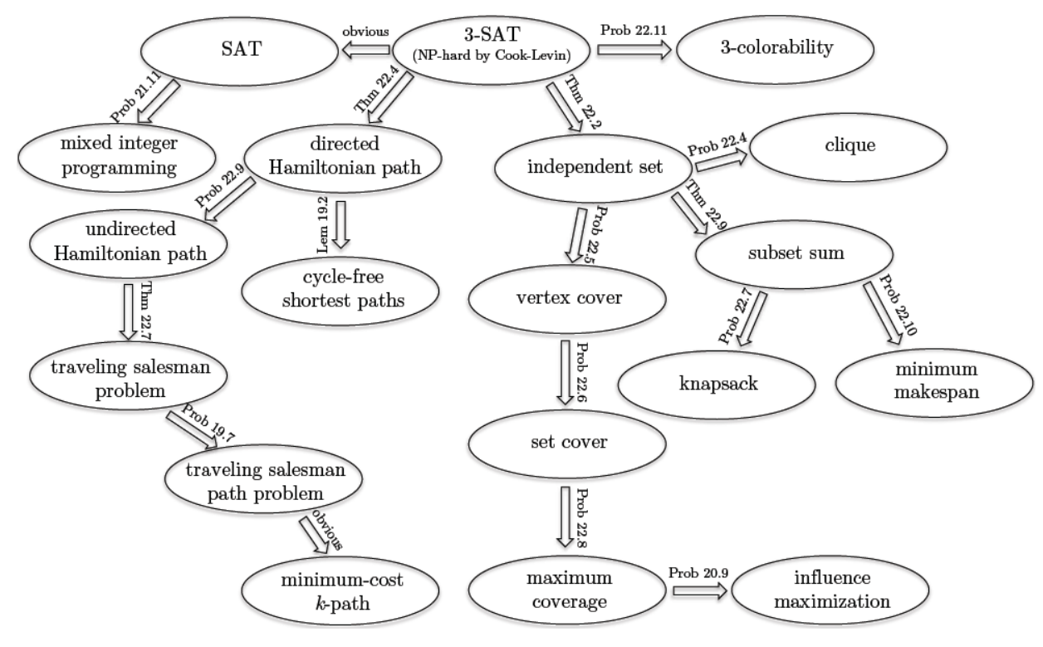
Cook-Levin theorem shows that 3-SAT is a “universal” problem

